Slide 1
WELCOME

Slide 2
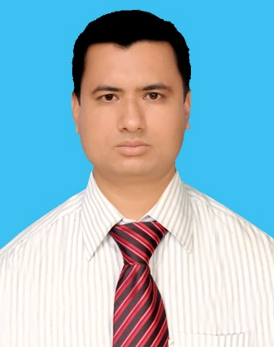
INTRODUCTION
MD. ZAMINUR ISLAM KHANDAKAR
Assi. Teacher [English]
ATI DASHRA GHUGOIL DAKHIL MADRASA.
Manjhar Bazar, Khetlal, Joypurhat.
Contact: 01720-690285

Slide 3
Today’s Lesson
Completing
Story

Slide 4
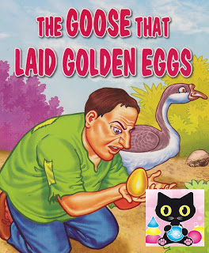

Slide 5
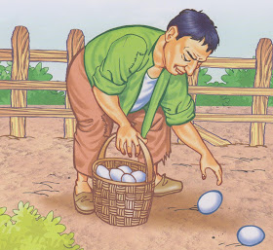
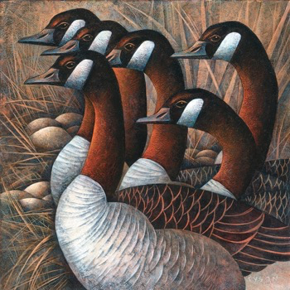
Once there was a poor farmer who had some geese.

Slide 6
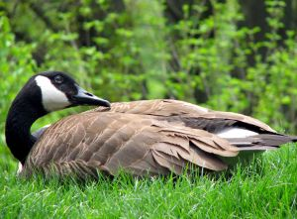
But of them one was very strange.

Slide 7
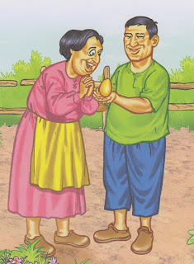
It was really a wonderful goose because it laid an golden egg everyday. So the farmer and his wife became very happy.

Slide 8
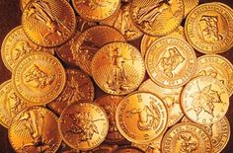
Selling the eggs in the market, he got much money and became rich.

Slide 9
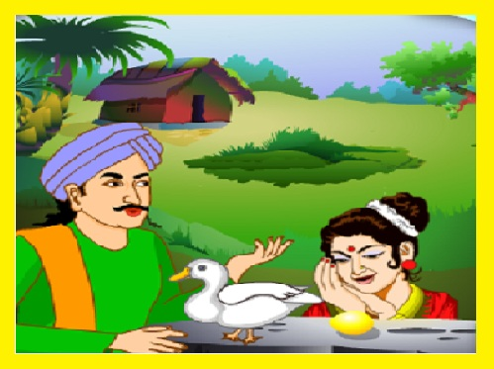
But the farmer was very greedy. He wanted to be the richest person overnight.

Slide 10
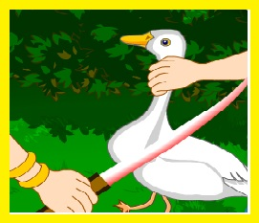
So he hit upon a plan. He cut the belly of the goose to get all the golden eggs at a time.

Slide 11
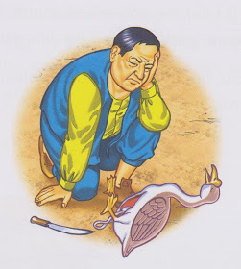
But alas! He found no egg in the belly of the wonderful goose. Then he realized his fault. He became very sad and began to repent.
He lost all for his greed and foolishness.

Slide 12
What is the moral of the story?
Grasp all, lose all.

Slide 13
Bye Bye
C U again………………

Slide 14
